Slide 1
Chapter 6
I/O devices
Notes:
不重要, 最多2-3分, 就填空选择会考，只需要知道概念，比如知道RIAD0-6

Slide 2
Two ways to measure throughput
I/O bandwidth can be measured in two different ways according to different situations:
1.How much data can we move through the system in a certain time?存储多少数据 For examples, in many supercomputer applications, most I/O requires are for long streams of data, and transfer bandwidth is the important characteristics.
2.How many I/O operations can we do per unit of time? 完成多少操作
For example, National Income Tax Service mainly
processes large number of small files.

Slide 3
2 Dependability, Reliability, and Availability

Slide 4
Reliability(可靠性）
MTTF mean tine to failure 平均无故障时间
MTTR mean time to repair 平均修复时间
MTBF (Mean Time Between Failures) 平均故障间隔时间 = MTTF+ MTTR
Availability（可用性）

Slide 5
提高MTTF
Fault avoidance避免故障:
preventing fault occurrence by construction
Fault tolerance:故障容忍
using redundancy to allow the service to comply with the service specification despite faults occurring, which applies primarily to hardware faults
Fault forecasting:故障预测
predicting the presence and creation of faults, which applies to hardware and software faults

Slide 6
3 Disk Storage

Slide 7
Nonvolatile
the data remains even when power is removed.
magnetic disks
hard disks
Hard Disc Drive
HD
1956, IBM, 30MB
温彻斯特式硬盘(温彻斯特来福枪)
1980，IBM员工创办SEAGATE
Increase 25%~30% per year
Vender： Western Digital、 Seagate、 Toshiba、EMC

Slide 8
The organization of hard disk
platters:
disk consists of a collection of platters （1-4）, each of which has two recordable disk surfaces
tracks:
each disk surface is divided into concentric circles（ typically 10,000 to 50,000 ）
sectors:
each track is in turn divided into sectors, which is the smallest unit that can be read or written（ each track may have 100 to 500 sectors. ）（512B-4096B）

Slide 9
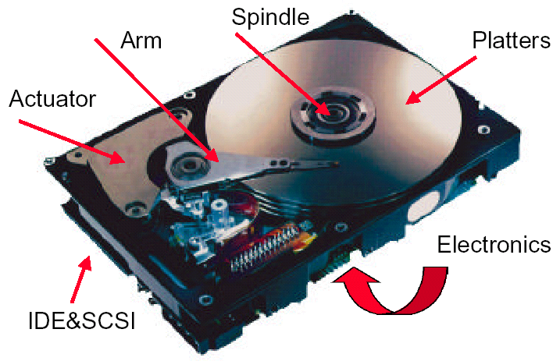
磁头，磁盘都是一叠
Disks are organized into platters, tracks, and sectors

Slide 10
Access the disk
Seek寻道: position read/write head over the proper track
minimum seek time
maximum seek time
average seek time (3 to 14 ms)
Rotational latency: wait for desired sector
average latency is the half-way round the disk.
0.5
rotation
0.5
rotation
Average rotational latency =
=
5400RPM
5400RPM
60
seconds
/
minute
= 0.0056
seconds =
5.6 ms
0.5
rotation
0.5
rotation
Average rotational latency =
=
15000RPM
15000RPM
60
seconds
/
minute
= 0.0020
seconds =
2.0 ms

Slide 11
Transfer: time to transfer a sector (512 B/sector) function of rotation speed, Transfer rate today’s drives - 30 to 80 MBytes/second
Disk controller: which control the transfer between the disk and the memory
Disk Read Time 512/sector
Access Time = Seek time + Rotational Latency + Transfer time + Controller Time
0.5
0.5KB
＝6ms ＋
＋
＋ 0.2ms
10,000PRM
50MB/sec
＝6ms ＋ 3.0 ＋ 0.01 ＋ 0.2 ＝9.2ms
Assuming the measured seek time is 25% of the calculated average
Access Time ＝25%×6ms ＋ 3.0 ms＋ 0.01ms ＋ 0.2ms ＝4.7ms

Slide 12
硬盘接口
IDE接口
Integrated Drive Electronics
电子集成驱动器，PATA并口，后发展为ATA
Advanced Technology Attachment (ATA)
A command set used as a standard for I/O devices that is popular in the PC.
SATA：Serial ATA，串口硬盘，2001年取代了ATA
SATA II：intel & Seagate，外部传输率从SATA的150MB/s提高到300MB/s
Small Computer Systems Interface (SCSI)
与IDE接口不一样，用于小型机以上
A command set used as a standard for I/O devices.
应用范围广、多任务、带宽大、CPU占用率低，以及热插拔等优点，但较高的价格
SAS（Serial Attached SCSI）

Slide 13
5 Connecting Processors, Memory, and I/O Devices

Slide 14
three characteristics of I/O systems:
1. Multiple programs using the processor share the I/O system.
2. I/O systems often use interrupts (externally generated exceptions) to communicate information about I/O operations. Because interrupts cause a transfer to kernel or supervisor mode, they must be handled by the operating system (OS).
3. The low-level control of an I/O device is complex, because it requires managing a set of concurrent events and because the requirements for correct device control are often very detailed.

Slide 15
Buses总线
Shared communication link (one or more wires)
Difficult design:
may be bottleneck很容易成为瓶颈
length of the bus
number of devices
tradeoffs (fast bus accesses and high bandwidth)
support for many different devices
cost

Slide 16
A bus contains two types of lines
Control lines 控制总线,它们用于发出请求和确认信号，并指示数据线上的信息类型
Data lines 数据总线, which carry information (e.g., data, addresses, and
complex commands) between the source and the destination.
Bus transaction 总线协议
include two parts: sending the address and receiving or
sending the data
two operations
input: inputting data from the device to memory
output: outputting data to a device from memory

Slide 17
The steps of an output operation.
Initial a read from memory. Control lines signal a read request to memory, while the data lines contain the address
Memory access the data.
Memory transfers data and signal data is available. The device stores data as it appears on the bus.

Slide 18
The steps of an input operation.
Control lines indicate a write request for memory, while the data lines contain the address
When the memory is ready, it signals the device, which then transfers the data. The memory will store the data as it receives it . The device need not wait for the store to be completed.

Slide 19
Types of buses:
processor-memory (short high speed, custom design)
backplane (high speed, often standardized, e.g., PCI)
I/O (lengthy, different devices, standardized, e.g., SCSI)
较旧的 PC 通常使用单总线进行处理器到内存的通信，以及 I/O 设备和内存之间的通信。

Slide 20
A separate bus is used for processor-memory traffic. The I/O bus use a bus adapter总线适配器to interface to the processor-memory bus.
A separate bus is used for processor-memory traffic. A small number of backplane buses背板总线tap into the processor-memory bus.

Slide 21
Synchronous bus use a clock and a synchronous protocol,
fast and small but every device must operate at same rate
and clock skew requires the bus to be short
Asynchronous bus don’t use a clock and instead use
handshaking 握手协议
Handshaking protocol
there are three control lines.
ReadReq读请求: Used to indicate a read request for memory. The address is
put on the data lines at the same time.
DataRdy 数据准备好了: Used to indicate that data word is now ready on the data lines.
Ack确认信号: Used to acknowledge the ReadReq or the DataRdy signal of the other party

Slide 22
Example: The asynchronous handshaking consists of seven steps to read a word from memory and receive it in an I/O device.
橙色是IO, 黑色是Mem的信号
读取的数据
When memory sees the ReadReq line, it reads the address from the data bus, begin the memory read operation，then raises Ack to tell the device that the ReadReq signal has been seen.
I/O device sees the Ack line high and releases the ReadReq data lines.
3. Memory sees that ReadReq is low and drops the Ack line.

Slide 23
When the memory has the data ready, it places the data on the data lines and raises DataRdy.
5. The I/O device sees DataRdy, reads the data from the bus , and signals that it has the data by raising ACK.
The memory sees Ack signals, drops DataRdy, and releases the data lines.
7. Finally, the I/O device, seeing DataRdy go low, drops the ACK line, which indicates that the transmission is completed.

Slide 25
Obtaining Access to the Bus
“Without any control, multiple device desiring to
communicate could each try to assert the control and
data lines for different transfers!”
So,a bus master is needed. Bus masters initiate and control all bus requests.
e.g., processor is always a bus master.
Example: the initial steps in a bus transaction with a
single master (the processor).
First, the device generates a bus request to indicate to the processor that it wants to use the bus.

Slide 26
The processor responds and generates appropriate bus control signals. For example, if the devices wants to perform output from memory, the processor asserts the read request lines to memory.
The processor also notifies the device that its bus request is being processed; as a result, the device knows it can use the bus and places the address for the request on the bus.

Slide 27
Bus Arbitration总线仲裁
决定下一个使用总线的总线主控器
在总线仲裁方案中，一个设备想要使用 bus 发出总线请求并随后被授予总线
four bus arbitration schemes:
daisy chain 链式结构 优先级高的一直可以用
centralized 集中式 , parallel arbitration (requires an arbiter), e.g., PCI
self selection 分布式, e.g., NuBus used in Macintosh
collision detection碰撞检测 试一下
Two factors in choosing which device to grant the bus:
bus priority 优先级
Fairness 公平

Slide 28
Bus Standards
SCSI (small computer system interface) 和嵌入式设备
PCI (peripheral component interconnect)
PCIE(PCI-Express) 1.0 2.0 3.0
IPI (intelligent peripheral interface)
IBMPC-AT IBMPC-XT
ISA EISA
USB 1.0. 2.0 3.0
IEEE1394

Slide 29
总线
总线的带宽
总线的带宽指的是一定时间内总线上可传送的数据量，即我们常说的每秒钟传送多少MB 的最大稳态数据传输率。与总线带宽密切相关的两个概念是总线的位宽和总线的工作时钟频率。
总线的位宽
总线的位宽指的是总线能同时传送的数据位数，即我们常说的32 位、64 位等总线宽度的概念。总线的位宽越宽则总线每秒数据传输率越大，也即总线带宽越宽。
总线的工作时钟频率
总线的工作时钟频率以MHz 为单位，工作频率越高则总线工作速度越快，也即总线带宽越宽。

Slide 30
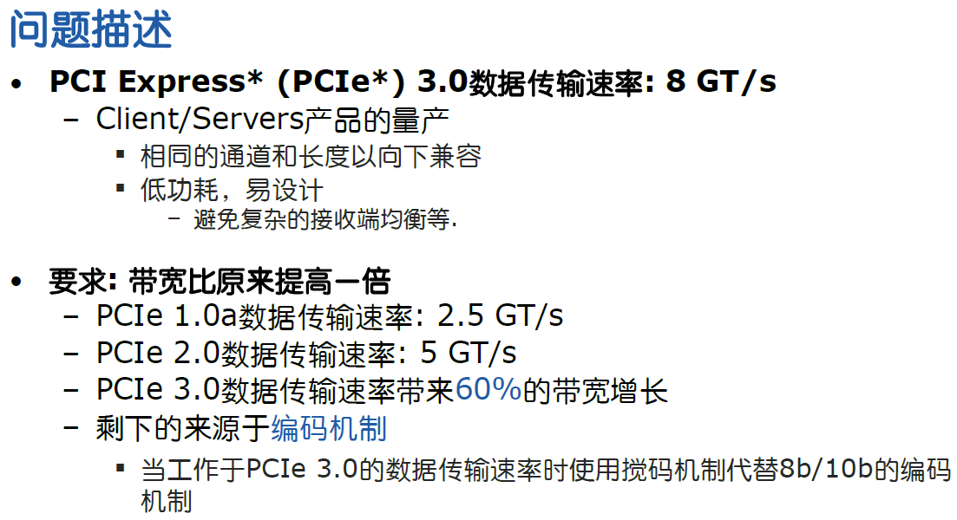

Slide 31
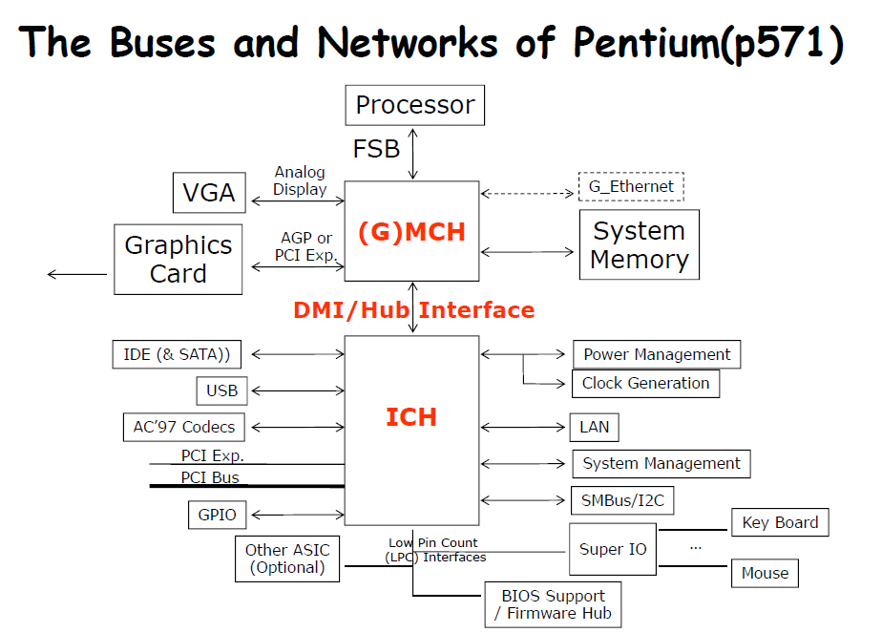

Slide 32
三大芯片
三大芯片
处理器
北桥
南桥
后两者合称芯片组
目前趋势
北桥部分做到处理器中，另外一部分与南桥合并

Slide 33
芯片组chip set
以往，芯片组由多颗芯片组成，慢慢的简化为两颗芯片
两个主要的主板芯片组：北桥和南桥
目前特指计算机主板或扩展卡上的芯片
单芯片芯片组
单个芯片设计，以增强性能
相关概念
主板Motherboard, Mainboard
主机板、系统板、逻辑板、母板、底板
最主要的器件为芯片组，以及各种接口（CPU插槽、硬盘插槽、内存插槽、PCIE插槽等）

Slide 34
北桥NorthBridge
也称为主桥（HostBridge），处理高速信号
接口：CPU、内存、AGP或PCI Express的端口
控制内存
Intel i7后，AMD K8后，在cpu中集成了内存控制器，北桥不需要控制内存
前端总线（FSB，Front Side Bus）
负责中央处理器和北桥芯片间的数据传递
时钟频率速度计算
传统：时钟频率速度=外频（前端总线、FSB）*倍频系数
现在系统总线、前端总线（外频、FSB）速率不一样
时钟频率速度=系统总线*倍频系数
例如Intel CPU使用了QDR（Quad Date Rate）技术
前端总线=系统总线*4

Slide 35
北桥相关概念
后端总线（Back Side Bus）
带有L2和L3缓存(Cache)的计算机，通过BSB实现这些缓存和中央处理器的连接，此总线的数据传输速率总是高于前端总线
Intel QPI
快速通道互联QuickPath Interconnect
点到点连接技术
20位宽的QPI连接带宽可达每秒25.6GB，峰值带宽可达96GB/s
酷睿i后使用QPI，放弃FSB，
AMD HT
HyperTransport
端到端的总线技术
HT3.0在2.6GHz高频率32bit高位宽运行模式下，可提供高达41.6GB/s的总线带宽

Slide 36
南桥South Bridge
负责控制主板的输入输出部分，
PCI总线、USB、LAN、ATA、SATA、音频控制器、键盘控制器、实时时钟控制器、高级电源管理等

Slide 37
6 Interfacing I/O Devices to the Processor, Memory, and Operating System

Slide 38
Three characteristics of I/O systems
shared by multiple programs using the processor.
often use interrupts to communicate information about I/O operations.
The low-level control of an I/O devices is complex
Three types of communication are required:
The OS must be able to give commands to the I/O devices.
The device must be able to notify the OS, when I/O device completed an operation or has encountered an error.
Data must be transferred between memory and an I/O device

Slide 39
Giving Commands to I/O Devices --Two methods used to address the device
memory-mapped I/O
一种I/O方案，其中地址空间的一部分被分配给I/O设备，对这些地址的读写被解释为对I/O设备的命令
Special I/O instruction
A dedicated instruction that is used to give a command to an I/O device and that specifies both the device number and the command word (or the location of the command word in memory).
Examples: In al, port; Out port, al
command port ,data port
The Status register (a done bit, an error bit……)
The Data register, The command register
How to know I/O information
开始→程序→附件→系统工具→系统信息

Slide 40
Communication with the Processor
I/O SYTEM DATA TRANSFER CONTROL MODE
Polling:处理器周期性地检查状态位，看是否到了下一次I/O操作的时间(CPU要花大量时间来查询，一般用在鼠标键盘）
Interrupt:当一个I/O设备想通知处理器它已经完成了一些操作或需要关注时，它会导致处理器被中断
DMA (direct memory access):设备控制器直接向内存传输数据（中间不经过CPU）或从内存传输数据，不涉及处理器（适合高速大量的数据）

Slide 41
Compare polling, interrupts, DMA
The disadvantage of polling is that it wastes a lot of processor time. When the CPU polls the I/O devices periodically， the I/O devices maybe have no request or have not get ready.
If the I/O operations is interrupt driven, the OS can work on other tasks while data is being read from or written to the device.
Because DMA doesn’t need the control of processor, it will not consume much of processor time.

Slide 42
Advantage: concurrent operation
Service for interruption
Service for interruption
Running
main program
go on doing
main program
main program
CPU
t
Response
interrupt
start
I/O
Response
interrupt
return
Interrupt return
Transfer
Data
Transfer
Data
Ready
Printing
Printing
t
Printer
Idle
start
Request
interrupt
Request
interrupt
Incept Data
Incept Data

Slide 43
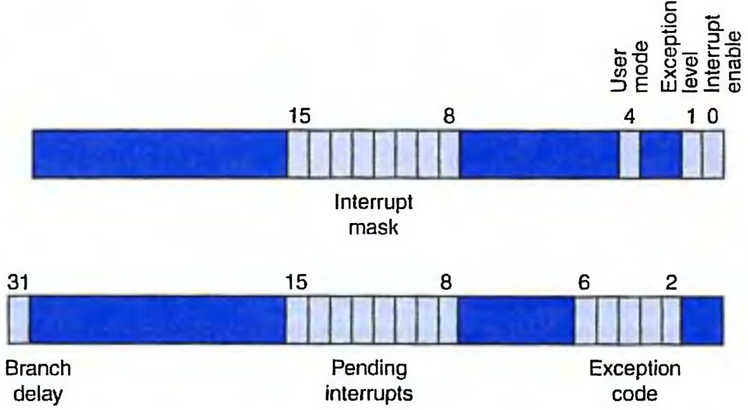
Interrupt Priority Levels
indicate the order in which the processor should process interrupts.
Status Register
Cause Register

Slide 44
Steps that must occur in handling an interrupt
1. Logically AND the pending interrupt field and the interrupt mask field to see which enabled interrupts could be the culprit. Copies are made of these two registers using the mr c0 instruction.
2. Select the higher priority of these interrupts. The software convention is that the leftmost is the highest priority.
3. Save the interrupt mask field of the Status register.
4. Change the interrupt mask field to disable all interrupts of equal or lower priority.
5. Save the processor state needed to handle the interrupt.
6. To allow higher-priority interrupts, set the interrupt enable bit of the Cause register to 1.
7. Call the appropriate interrupt routine.
8. Before restoring state, set the interrupt enable bit of the Cause register to 0. This allows you to restore the interrupt mask field.

Slide 45
Order of interruption processing
Priority of Hardware
D1, D2, D3, D4 → highest 1>2>3>4 lowest
Coming IRQ Main H1, H2, H3, H4
D3, D2
D4
D1
Time t

Slide 46
Why we need Interrupt Mask ?
Change the order of interruption processing ( handle lower level interrupt first in some extend)
To decide whether a I/O unite work on interruption way
In a multiprocessor system, distribute the I/O tasks to multiprocessor

Slide 47
Changing interrupt processing order
I/O unit | Hardware priority | interrupt mask1 D1 D2 D3 D4 | Interrupt mask2 D1 D2 D3 D4
D1 | 1 | 1 1 1 1 | 1 0 0 0
D2 | 2 | 0 1 1 1 | 1 1 0 0
D3 | 3 | 0 0 1 1 | 1 1 1 0
D4 | 4 | 0 0 0 1 | 1 1 1 1

Slide 48
Using the interrupt mask1
Coming IRQ Main H1, H2, H3, H4
D3, D2
D4
D1
Time t

Slide 49
DMA transfer mode
CPU
DMA
I/O DEVICE
memory
CPU INITIATION DMA
NO DMA I/O-CPU--M
DMA-- I/O---M I/O DIRECT ACCESS MEMORY

Slide 50
Steps of DMA transfer
The processor sets up the DMA by supplying some information, including the identity of the device, the operation, the memory address that is the source or destination of the data to be transferred, and the number of bytes to transfer.
The DMA starts the operation on the device and arbitrates for the bus. If the request requires more than one transfer on the bus, the DMA unit generates the next memory address and initiates the next transfer.
一旦DMA传输完成，控制器会中断处理器，然后检查是否发生错误。

Slide 51
7 I/O Performance Measures: Examples for Disk and File Systems

Slide 52
Supercomputer超级计算机 I/O Benchmarks
Transaction Processing I/O Benchmarks
I/O rate: the number of disk access per second, as opposed to data rate.
File System I/O 文件管理Benchmarks
MakeDir, Copy, ScanDir, ReadAll, Make

Slide 53
Performance analysis of
Synchronous vs. Asynchronous buses
Assume: The synchronous bus has a clock cycle time of 50 ns, and each
bus transmission takes 1 clock cycle .
The asynchronous bus requires 40 ns per handshake.
The data portion of both buses is 32 bits wide.
Question: Find the bandwidth for each bus when reading one word from a 200-ns memory.
synchronous bus:
the bus cycles is 50 ns. The steps and times required for the
synchronous bus are follows:
1. Send the address to memory : 50ns
2. Read the memory : 200ns
3. Send the data to the device : 50ns
Thus, the total time is 300 ns. So,
the bandwidth = 4bytes/300ns = 4MB/0.3seconds = 13.3MB/second
Answer:

Slide 54
asynchronous bus:
handshake overlap with the memory access time.
memory receives the address at the end of step 1
Memory not need to put the data on the bus until the beginning of step 5;
steps 2, 3, and 4 can
overlap with the memory
access time.
This leads to the following timing:
step1: 40ns
step2,3,4: maximum(2×40ns+40ns, 200ns)=200ns
step5,6,7: 3×40ns=120ns
Thus, the total time is 360ns, so
the maximum bandwidth = 4bytes/360ns = 4MB/0.36sec = 11.1MB/second
Accordingly, the synchronous bus is about 20% faster.

Slide 55
Increasing the Bus Bandwidth
Increasing data bus width
Use separate address and data lines
transfer multiple words
Performance Analysis of Two Synchronous Bus Schemes.
Suppose we have a system with the following characteristic:
1. A memory and bus system supporting block access of 4 to 16 32-bit words
2. A 64-bit synchronous bus clocked at 200 MHz, with each 64-bit transfer taking 1 clock cycle, and 1 clock cycle required to send an address to memory.
3. Two clock cycles needed between each bus operation.
4. A memory access time for the first four words of 200ns; each additional set of four words can be read in 20 ns. Assume that a bus transfer of the most recently read data and a read of the next four words can be overlapped.

Slide 56
Find the sustained bandwidth and the latency for a read of 256 words for transfers that use 4-word blocks and for transfers that use 16-word blocks.
Also compute effective number of bus transactions per second for each case.

Slide 57
Answer:
64-bit synchronous bus
the 4-word block transfers:
each block takes
1. 1 clock cycle to send the address to memory
2. 200ns/(5ns/cycle) = 40 clock cycles to read memory
3. 2 clock cycles to send the data from the memory
4. Two clock cycles needed between each bus operation.
This is a total of 45cycles.
There are 256/4 = 64 blocks.
So the transfer of 256 words takes
45×64=2880 clock cycles
The latency for the transfer of 256 words is:
2880 cycles× 5ns/cycle = 14,400ns.

Slide 58
so the number of bus transactions per second is:
The bus bandwidth is:
1second
(256
×
4)bytes
×
＝
71.11 MB/sec
14,
400
ns

Slide 59
the 16-word block transfers:
the first block requires
1. 1 clock cycle to send an address to memory
2. 200ns or 40 cycles to read the first four words in memory.
3. 2 cycles to transfer the data of the set, during which time the read of the next 4-word set is started.
4. It only takes 20ns or 4 cycles to read the next set. After the read is completed, the set will be transferred. Each of the three remaining sets requires repeating only the last two steps.
5. Two clock cycles needed between each bus operation.

Slide 60
Thus, the total number of cycles for each 16- word block is:
1+40+4×3+2+2=57 cycles.
There are 256/16=16 blocks.
so the transfer of 256 words takes 57×16=912 cycles.
Thus the latency is:
912cycles× 5ns/cycles = 4560ns.
Note that the bus size need to be 128 bits !
1+40+4 + 8*3 = 69 cycles
69*16 = 1104 cycles
1104 * 5ns = 5520ns
send
read
send
read
send
read
send
read
send
read
send
read
read
read
send
send
interval
interval
interval
interval
interval
interval
interval
1
40
40
4(20ns)
4(20ns)
4(next)
4(next)
4(next)
4(next)

Slide 61
The number of bus transactions per second with 16-word blocks is:
1second
(16
transactions
×
＝
2.90 M Transactions/sec
5520
ns
The bus bandwidth with 16-word blocks is:
1second
(256
×
4)bytes
×
＝
224.56 MB/sec
4560
ns
1second
(256
×
4)bytes
×
＝
185.50 MB/sec
5520
ns
Now,let’s put two bus bandwidth together:
4-word blocks: 71.11 MB/sec; 16-word blocks:224.56 MB/sec
The bandwidth for the 16-word blocks is 3.16 times higher than for the 4-word blocks.
2.6 times

Slide 62
Overhead of Polling in an I/O System
Assume: that the number of clock cycles for a polling operation is
400 and that processor executes with a 500-Mhz clock.
Determine the fraction of CPU time consumed for the mouse, floppy disk, and hard disk.
We assuming that you poll often enough so that no data is ever lost and that those devices are potentially always busy.
We assume again that:
1. The mouse must be polled 30 times per second to ensure that we do not miss any movement made by the user.
2. The floppy disk transfers data to the processor in 16-bit units and has a data rate of 50 KB/sec. No data transfer can be missed.
3. The hard disk transfers data in four-word chunks and can transfer at 4 MB/sec. Again, no transfer can be missed.

Slide 63
Answer:
the mouse:
clock cycles per second for polling :
30×400=12,000 cycles
Fraction of the processor clock cycles consumed is
the floppy disk:
the number of polling access per second:
50KB/2B = 25K
clock cycles per second for polling: 25K×400cycles
Fraction of the processor clock cycles consumed:

Slide 64
the hard disk:
The number of polling access per second : 4MB/16B = 250K
Clock cycles per second for polling = 250K×400
Fraction of the processor clock cycles consumed:
Now, let’s put three fractions together:
Mouse: 0.002%
Floppy disk: 2%
Hard disk: 20%
Clearly, polling can be used for the mouse without much performance impact on the processor, but it is unacceptable for a hard disk on this machine.

Slide 65
Suppose we have the same hard disk and processor we used in the former example, but we used interrupt-driven I/O. The overhead for each transfer, including the interrupt, is 500 clock cycles. Find the fraction of the processor consumed if the hard disk is only transferring data 5% of the time.
Answer: First, we assume the disk is transferring data 100% of the time. So, the interrupt rate is the same as the polling rate.
Cycles per second for disk is:
250K×500=125×10⁶cycles per second Fraction of the processor consumed during a transfer is:

Slide 66
Now,we assume that the disk is only transferring data 5% of the time.The fraction of the processor time consumed on average is:
25%×5%=1.25%
As we can see, no CPU time is needed when an interrupt-driven I/O device is not actually transferring. This is the major advantage of an interrupt-driven interface versus polling.

Slide 67
Overhead of I/O Using DMA
Suppose we have the same hard disk and processor we used in the former example.
Assume that the initial setup of a DMA transfer takes 1000 clock cycles for the processor, and assume the handling of the interrupt at DMA completion requires 500 clock cycles for the processor.
The hard disk has a transfer rate of 4MB/sec and uses DMA. The average transfer from disk is 8 KB. Assume the disk is actively transferring 100% of the time.
Please find what fraction of the processor time is consumed.

Slide 68
Time for each 8KB transfer is: 8KB/(4MB/second)=2×10⁻³seconds. It requires the following cycles per second:
Answer
Fraction of processor time:
Unlike either polling or interrupt-driven I/O, DMA can be used to interface a hard disk without consuming all the processor cycles for a single I/O.

Slide 69
6.8 Designing an I/O system
The general approaches to designing I/O system
Find the weakest link in the I/O system, which is the component in the I/O path that will constrain the design. Both the workload and configuration limits may dictate where the weakest link is located.
Configure this component to sustain the required bandwidth.
Determine the requirements for the rest of the system and configure them to support this bandwidth.

Slide 70
I/O System Design
Examples:
Consider the following computer system:
1. A CPU sustains 3 billion instructions per second and it takes average 100,000 instructions in the operating system per I/O operation.
2. A memory backplane bus is capable of sustaining a transfer rate of 1000 MB/sec.
3. SCSI-Ultra320 controllers with a transfer rate of 320 MB/sec and accommodating up to 7 disks.
4. Disk drives with a read/write bandwidth of 75 MB/sec and an average seek plus rotational latency of 6 ms.

Slide 71
If the workload consists of 64-KB reads (assuming the the data block is sequential on a track), and the user program need 200,000 instructions per I/O operation, please find the maximum sustainable I/O rate and the number of disks and SCSI controllers required.
Answer:
The two fixed component of the system are the memory bus and the CPU. Let’s first find the I/O rate that these two components can sustain and determine which of these is the bottleneck.

Slide 72
Instruction execution rate
Maximum I/O rate of CPU =
Instruction per I/O
3
×
10
9
I/Os
=
＝
10000
3
seconds
(200
＋
100)
×
10
Bus bandwidth
1000
×
10
6
I/Os
Maximum I/O rate of bus =
=
= 15625
Bytes per I/O
64
×
10
3
seconds
The CPU is the bottleneck, so we can now configure the rest of the system to perform at the level dictated by the bus, 10000 I/Os per second.

Slide 73
Now, let’s determine how many disks we need to be able to Accommodate 10000 I/Os per second. To find the number of disks, we first find the time per I/O operation at the disk:
Time per I/O at disk =
Seek/rotational time + Transfer time
64KB
= 6 ms
＋
= 6.9 ms
75MB/sec
This means each disk can complete 1000ms/6.9ms, or 146 I/Os per second. To saturate the bus, the system need 10000/146≈69 disks.

Slide 74
To compute the number of SCSI buses, we need to know the average transfer rate per disk, which is given by:
Transfer size
64KB
Transfer rate =
=
≈ 9.56MB/sec
Transfer time
6.9ms
Assuming the disk accesses are not clustered so that we can use all the bus bandwidth, we can place 7 disks per bus and controller. This means we will need 69/7, or 10 SCSI buses and controllers.

Slide 75
Interrupt-driven IO
Interrupts were introduced.
External device signals need to be serviced.
Processor saves state and starts service routine.
When finished, processor restores state and resumes program.

Slide 76
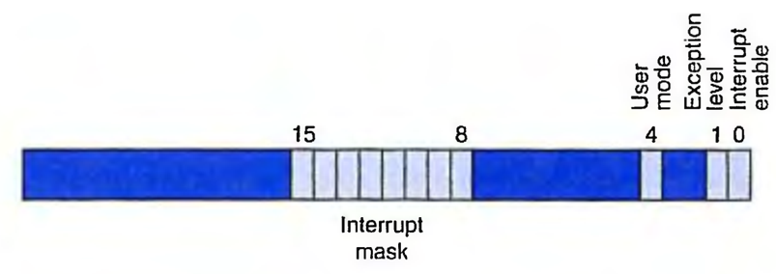
Process State
What state is needed to completely capture the state of a running process?
Processor Status Register--PSR
Program Counter
Pointer to next instruction to be executed.
Registers
All temporary state of the process that’s not stored in memory.

Slide 77
Where to Save Processor State?
Can’t use registers.
Programmer doesn’t know when interrupt might occur, so she can’t prepare by saving critical registers.
When resuming, need to restore state exactly as it was.
Memory allocated by service routine?
Must save state before invoking routine, so we wouldn’t know where.
Also, interrupts may be nested – that is, an interrupt service routine might also get interrupted!
Use a stack!
Location of stack “hard-wired”.
Push state to save, pop to restore.

Slide 78
Supervisor Stack
A special region of memory used as the stack for interrupt service routines.
Initial Supervisor Stack Pointer (SSP) stored in Saved.SSP.
Another register for storing User Stack Pointer (USP): Saved.USP.
SP(R29) as stack pointer.
So that our PUSH/POP routines still work.
When switching from User mode to Supervisor mode (as result of interrupt), save (R29) to Saved.USP.

Slide 79
Invoking the Service Routine and back
Save the PC of the instruction stage to EPC, so that can return back from exception handler.
Close interrupt to avoid any other intervention in interrupt handling. Entering kernel mode (set supervisor mode). Save the current mode EM.
Transfer to exception handler via setting PC to EHB
Protect processor state: save all GPRs to stack; Save EPC and interrupt cause register to supervisor stack.
Handling the interrupt ……
Restore processor state: restore all GPRs from stack.
Return back to the interrupt point （ERET)： open interrupt, set PC to EPC ) , back to the old mode EM.

Slide 80
6.9 Parallelism and I/O: Redundant Arrays of Inexpensive Disks

Slide 81
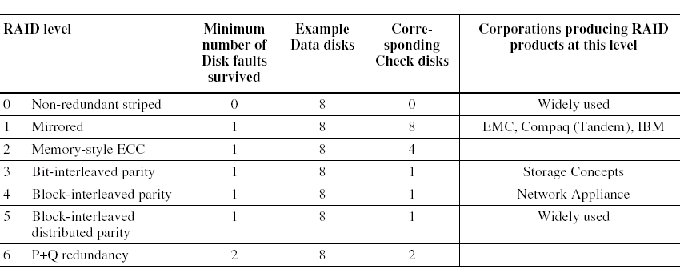
Impact of I/O on System Performance
Elapsed time= CPU time + I/O time
RAID
redundant arrays of inexpensive disks

Slide 82
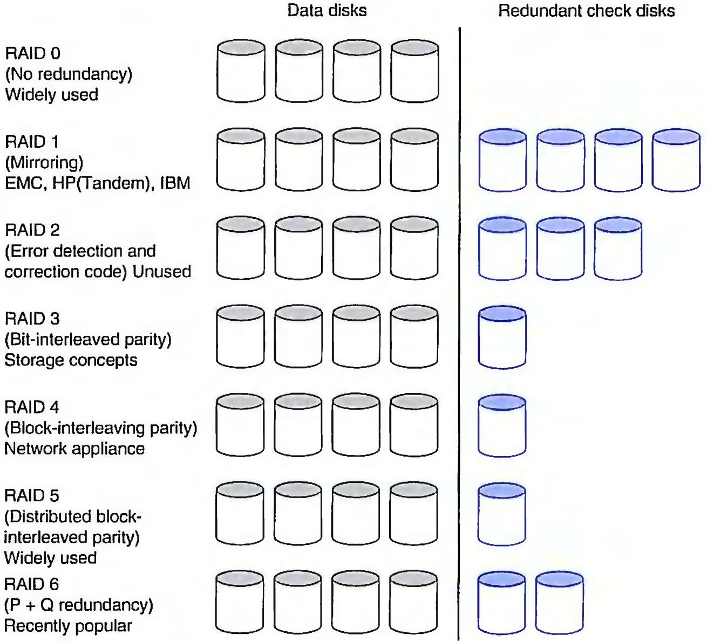
RAID: Redundant Arrays of Inexpensive Disks
A disk arrays replace larger disk

Slide 83
Use Arrays of Small Disks?
Katz and Patterson asked in 1987:
Can smaller disks be used to close gap in performance between disks and CPUs?
Conventional: 4 disk designs
3.5”
5.25”
10”
14”
Low End
High End
Disk Array: 1 disk design
3.5”

Slide 84
Array Reliability
Reliability of N disks = Reliability of 1 Disk ÷ N
50,000 Hours ÷ 70 disks = 700 hours
Disk system MTTF: Drops from 6 years to 1 month!
• Arrays (without redundancy) too unreliable to be useful!
Hot spares support reconstruction in parallel with access: very high media availability can be achieved

Slide 85
Redundant Arrays of (Inexpensive) Disks
Files are "striped" across multiple disks
Redundancy yields high data availability
Availability: service still provided to user, even if some components failed
Disks will still fail
Contents reconstructed from data redundantly stored in the array
⇒ Capacity penalty to store redundant info
⇒ Bandwidth penalty to update redundant info

Slide 86
RAID 0: No Redundancy 没有冗余
• Data is striped across a disk array but there is no redundancy to tolerate disk failure.
It also improves performance for large accesses,
since many disks can operate at once.
RAID 0 something of a misnomer as there is no Redundancy,

Slide 87
RAID 1: Disk Mirroring/Shadowing 镜像备份
recovery
group
• Each disk is fully duplicated onto its “mirror”
Very high availability can be achieved
• Bandwidth sacrifice on write:
Logical write = two physical writes
Reads may be optimized
• Most expensive solution: 100% capacity overhead
RAID 2不用了

Slide 88
RAID 3: Bit-Interleaved Parity Disk
10010011
11001101
10010011
. . .
P
logical record
1
0
1
0
0
0
1
1
1
1
0
0
1
1
0
1
1
0
1
0
0
0
1
1
1
1
0
0
1
1
0
1
Striped physical
records
P contains sum of
other disks per stripe mod 2 (“parity”)
If disk fails, subtract
P from sum of other disks to find missing information
按位奇偶校验
要访问时间很长，但是用于校验的空间较小

Slide 89
RAID 4: High I/O Rate Parity
Increasing
Logical
Disk
Address
D0
D1
D2
D3
P
Insides of 5 disks
D4
D5
D6
D7
P
D8
D9
D10
D11
P
Example:
small read D0 & D5, large write D12-D15
D12
D13
D14
D15
P
Stripe
D16
D17
D18
D19
P
D20
D21
D22
D23
P
块交叉
.
.
.
.
.
.
.
.
.
.
.
.
.
.
.
Disk Columns

Slide 90
Inspiration for RAID 4
RAID 3 依靠奇偶校验磁盘来发现读取错误
但是每个扇区都有一个错误检测字段
依靠错误检测字段来捕获读取时的错误，而不是奇偶校验磁盘上的错误
允许同时独立读取不同的磁盘

Slide 91
Problems of Disk Arrays: Small Writes
RAID-5: Small Write Algorithm
1 Logical Write = 2 Physical Reads + 2 Physical Writes
D0'
D0
D1
D2
D3
P
new
data
old
data
(1. Read)
old
parity
(2. Read)
+
XOR
+
XOR
(3. Write)
(4. Write)
D0'
D1
D2
D3
P'

Slide 92
Inspiration for RAID 5
RAID 4 works well for small reads
Small writes (write to one disk):
Option 1: read other data disks, create new sum and write to Parity Disk
Option 2: since P has old sum, compare old data to new data, add the difference to P
Small writes are limited by Parity Disk: Write to D0, D5 both also write to P disk
D0
D1
D2
D3
P
D4
D5
D6
D7
P

Slide 93
RAID 5: High I/O Rate Interleaved Parity
D0
D1
D2
D3
P
Increasing
Logical
Disk
Addresses
Independent writes
possible because of
interleaved parity
D4
D5
D6
P
D7
D8
D9
P
D10
D11
D12
P
D13
D14
D15
Example: write to D0, D5 uses disks 0, 1, 3, 4
P
D16
D17
D18
D19
D20
D21
D22
D23
P
.
.
.
.
.
.
.
.
.
.
.
.
.
.
.
Disk Columns

Slide 94
RAID 6: P+Q Redundancy
When a single failure correction is not sufficient, Parity can be generalized to have a second calculation over data and another check disk of information.

Slide 95
Summary: RAID Techniques: Goal was performance, popularity due to reliability of storage
1
0
0
1
0
0
1
1
1
0
0
1
0
0
1
1
• Disk Mirroring, Shadowing (RAID 1)
Each disk is fully duplicated onto its "shadow"
Logical write = two physical writes
100% capacity overhead
• Parity Data Bandwidth Array (RAID 3)
1
0
0
1
0
0
1
1
1
1
0
0
1
1
0
1
1
0
0
1
0
0
1
1
0
0
1
1
0
0
1
0
Parity computed horizontally
Logically a single high data bw disk
• High I/O Rate Parity Array (RAID 5)
Interleaved parity blocks
Independent reads and writes
Logical write = 2 reads + 2 writes
Notes:
RAID只要掌握每个的特点就行

